Slide 1

MPLS 37: Applying machine learning to predict binding affinity of ligands for SARS-CoV-2 Mpro
Mariya Boshar, Edoardo Fratantonio, Gurpreet Beghal
Supervisor: Prof. Garrett Morris

Slide 2

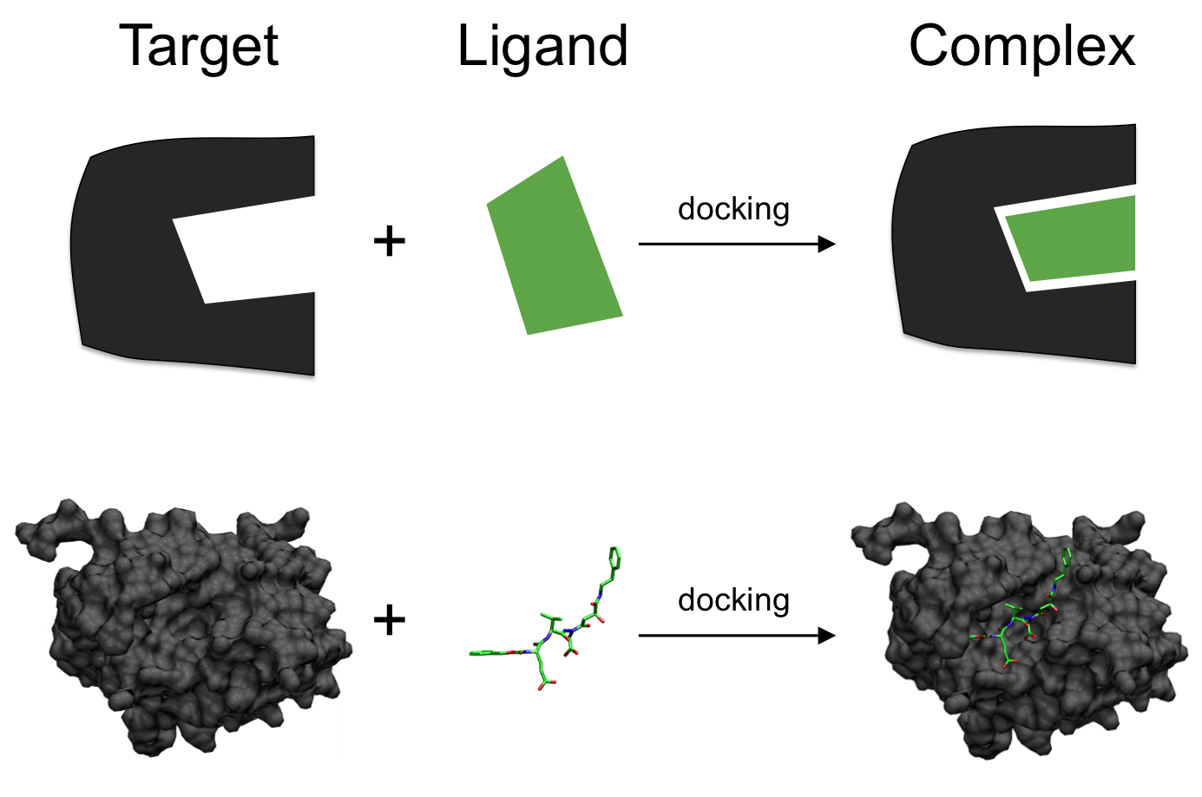
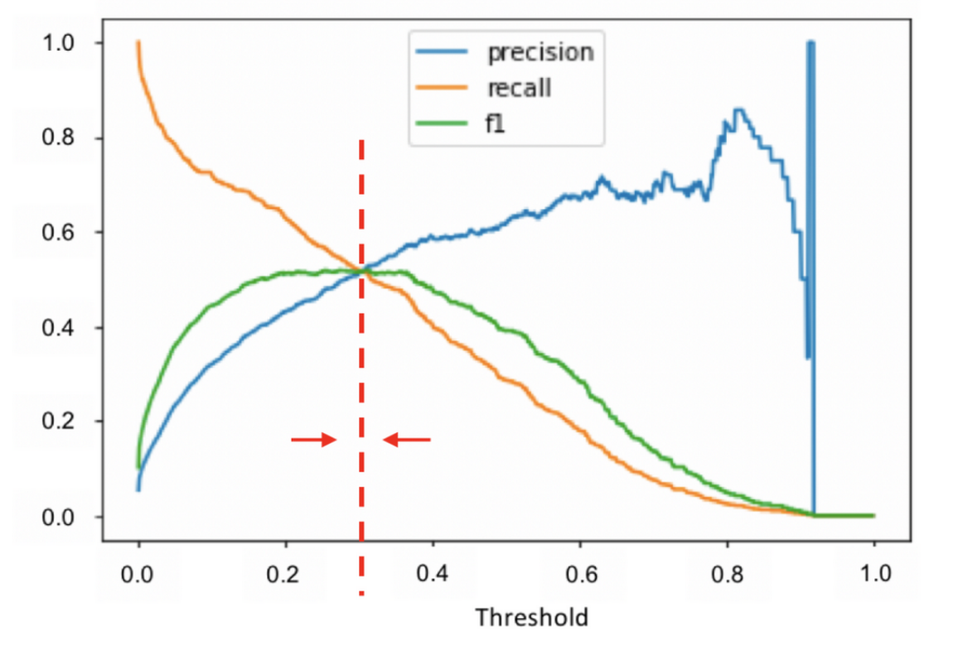
Project Timeline
Implementing accuracy and F1 scoring functions
Accessing ARC
Relaying research to supervisor
Discussing ongoing research within the OPIG Group
Week 1 & 2
Week 3
Week 4 & 5
Week 6
Week 1: Training courses into AI and machine learning
Week 2: Background literature review of project
Aim: To apply machine learning models to COVID Moonshot dataset (Mpro activity data)
Adjusting machine learning parameters
Researching into molecular docking- AEScore and Protein Ligand Interaction Graphs

Slide 3
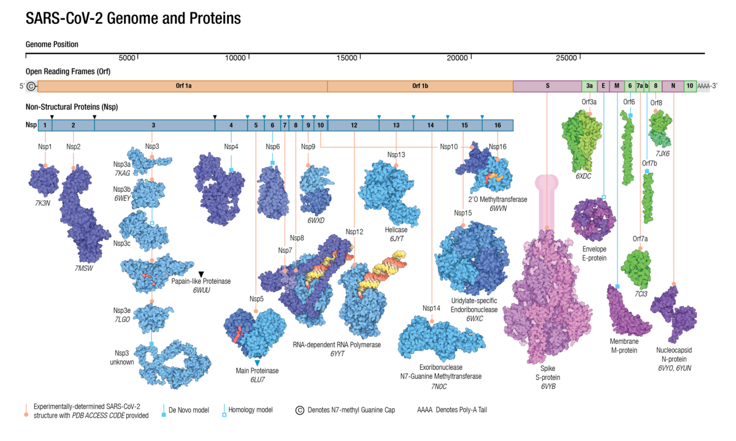
Why is MPro important to target?

Slide 4
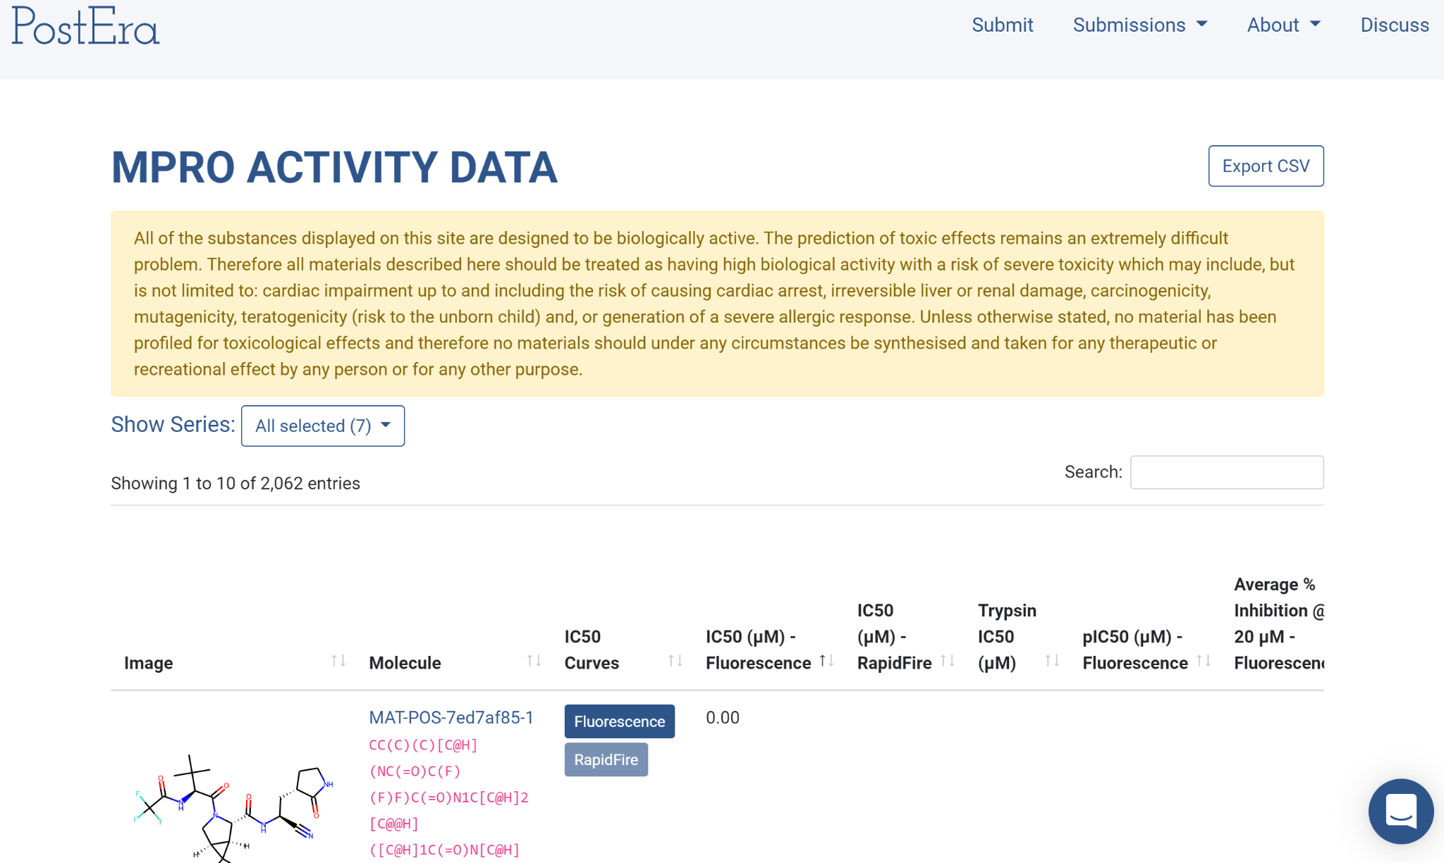
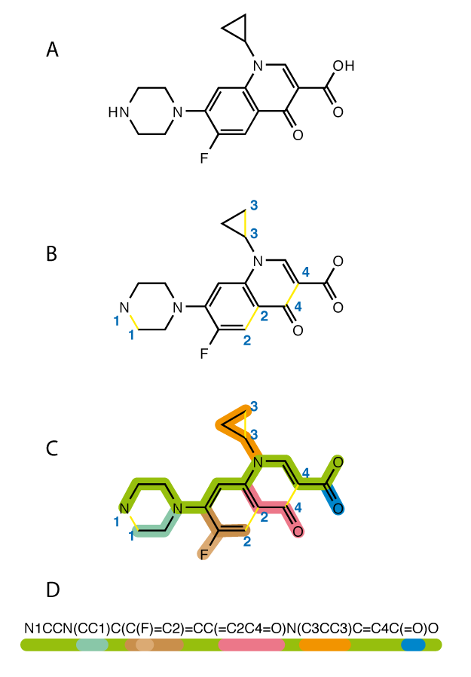
Discovering inhibitors through predicting binding affinity to MPro
IC50 data (fluorescence)
SMILES- Simplified Molecular Input Line-Entry System

Slide 5
What is Machine Learning?
Machine Learning
Supervised Learning
Unsupervised Learning
Reinforcement Learning
Supervised Learning
Given X -> Data and Y -> Labels, predicting Y
Examples:
Classification
Regression
Models:
Random Forest
Neural Network
Naive Bayesian

Slide 6
Approach Used
Converting the IC50 values from micromolar to pIC50.
Cleaning the dataset from any missing label.
In order for the machine learning model to understand what a SMILE means, it needs to be featurized, meaning, translating the SMILES to something that the computer can understand, 0s and 1s.
Split the dataset into Training(75%) and Test(25%) set, using the Scaffold splitter.
After building each model we performed cross validation to evaluate the performance of the model using certain hyperparameters.
Notes:
Group molecules based on the Bemis-Murcko scaffold representation,
which identifies rings, linkers,and atomic properties
such as atom type, bond order in a dataset of molecules.
Then split the groups by the number of molecules in decreasing order.

Slide 7
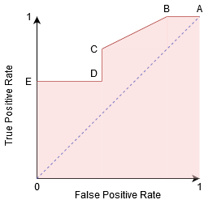
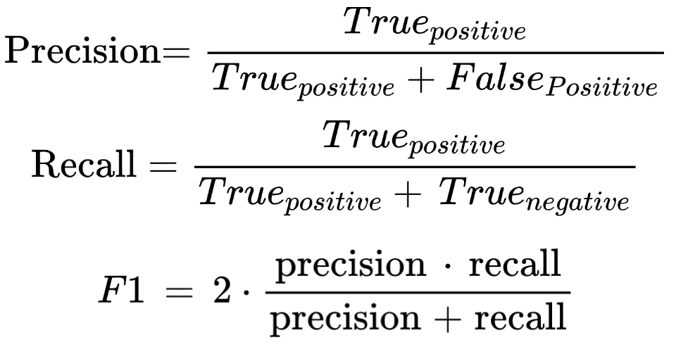
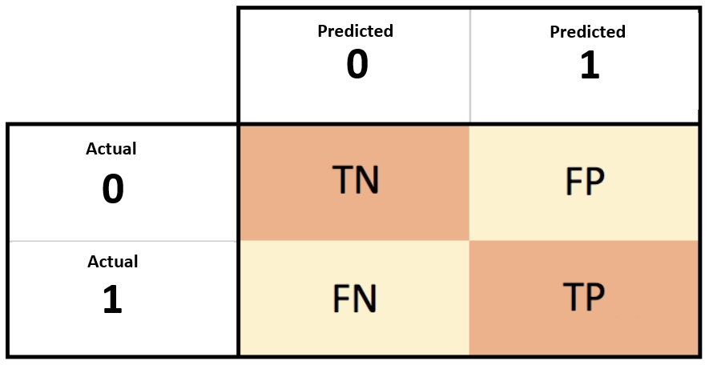
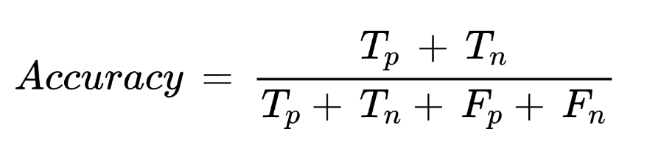
Metrics
ROC AUC
Accuracy
F1 score
Confusion Matrix
[Confusion Matrix Image] Narkhede, Sarang. “Understanding Confusion Matrix | by Sarang Narkhede | Towards Data Science.” Medium, towardsdatascience.com, 15 June 2021, https://towardsdatascience.com/understanding-confusion-matrix-a9ad42dcfd62.

Slide 8
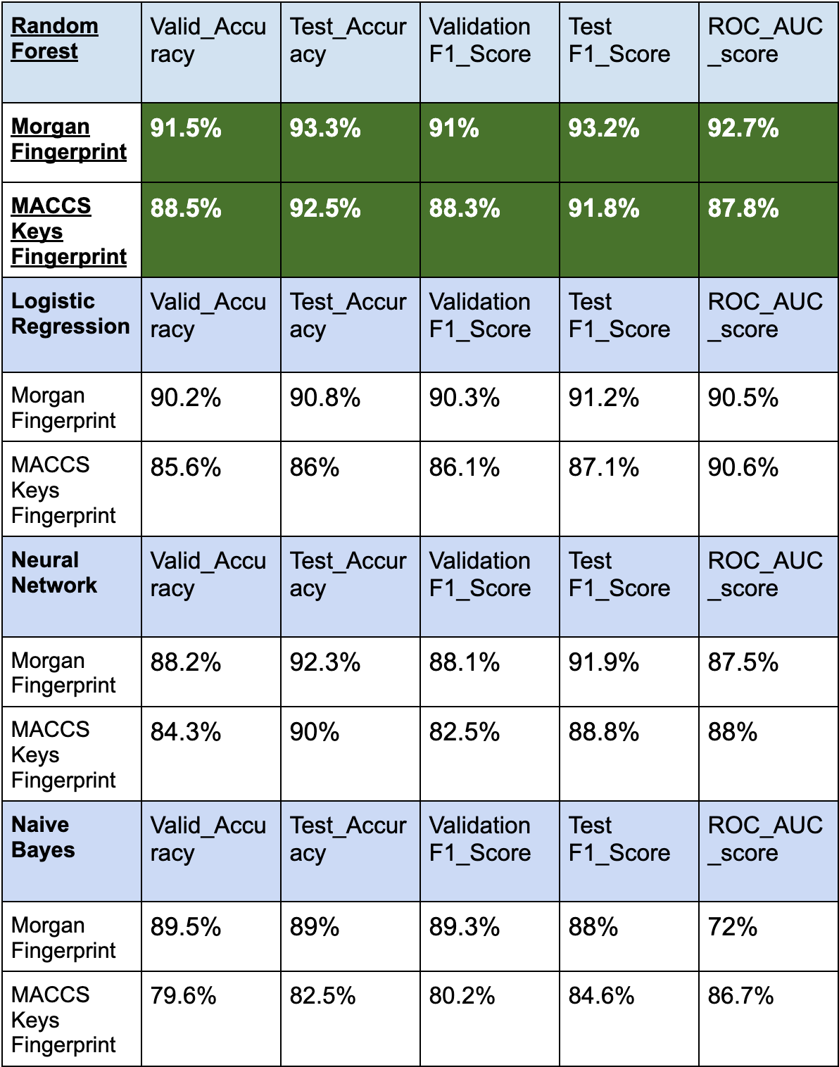
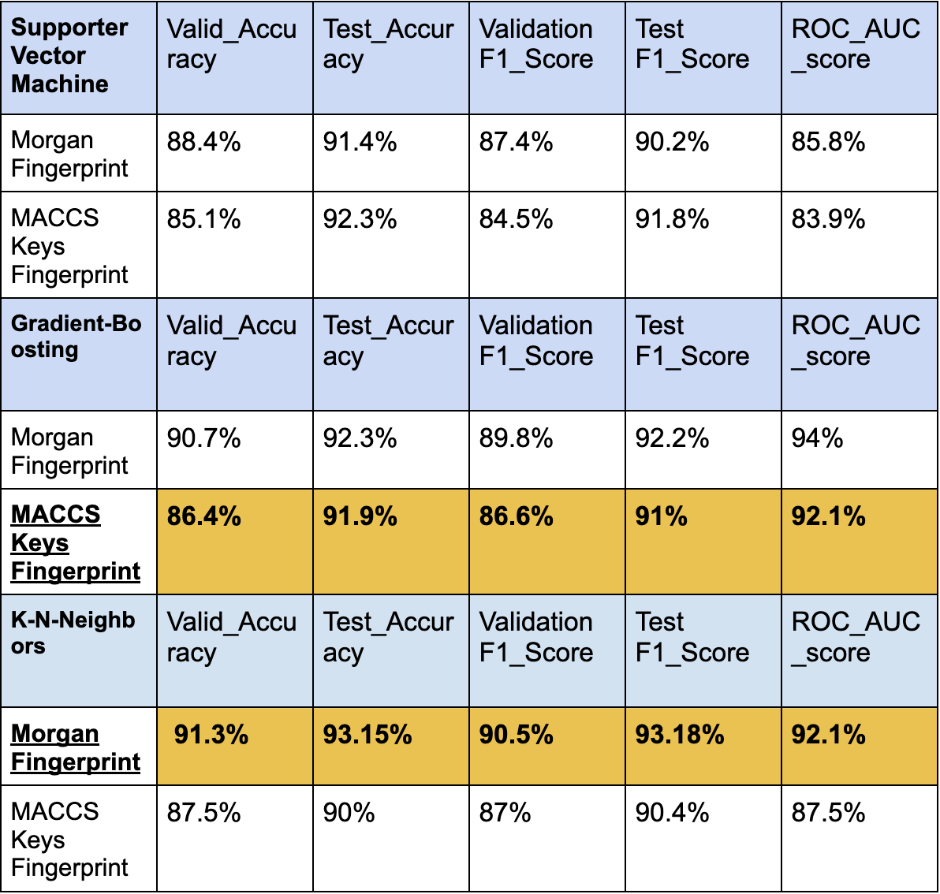
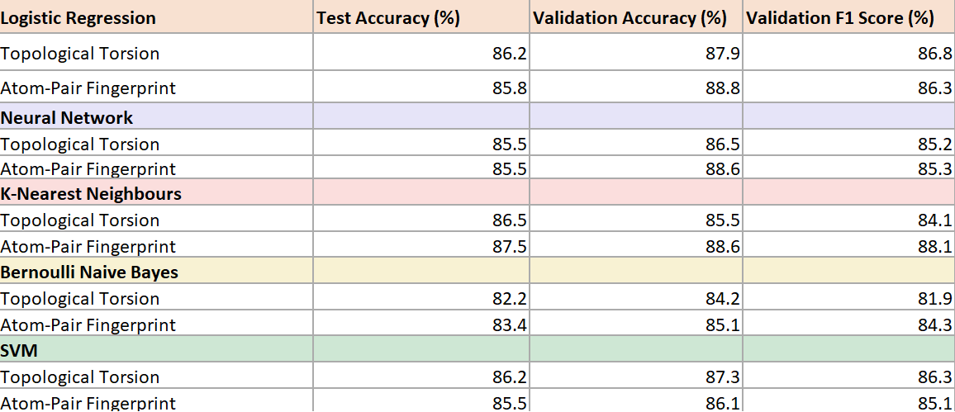
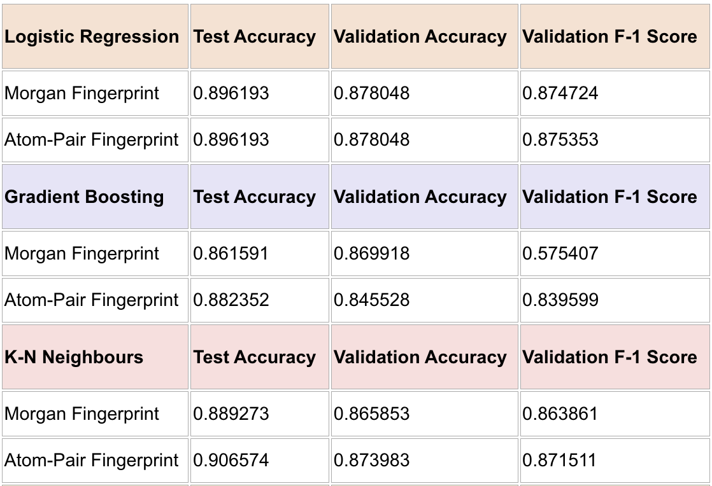
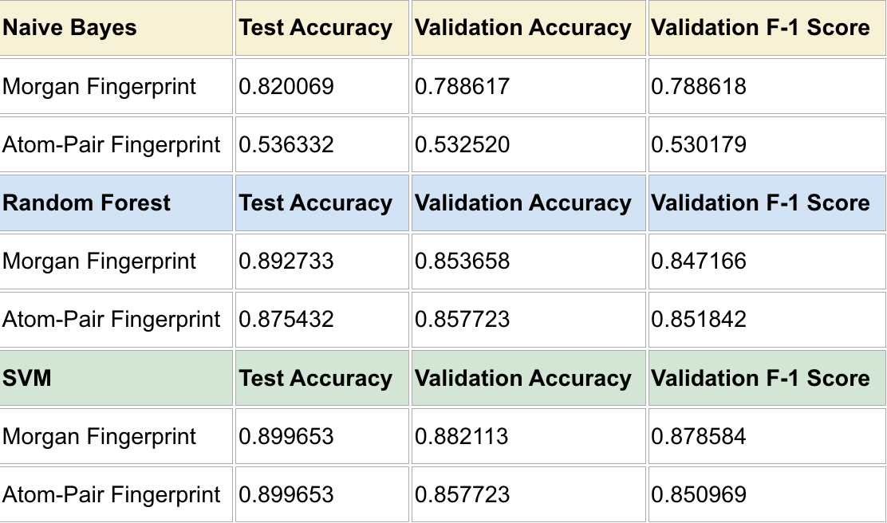
Best Performing Models
Mariya’s Results
Gurpreet’s Results
Edoardo’s Results
= 1st Best = 2nd Best
Github code repo: https://github.com/edofrata/ML_AI_SARS-CoV-2_Oxford

Slide 9
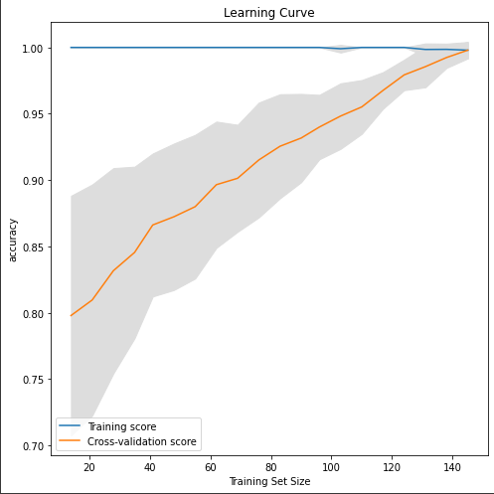
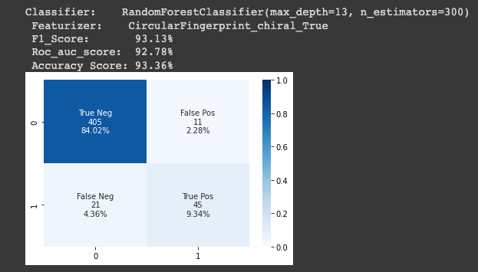
Random Forest Graphs
Confusion Matrix

Slide 10
Future Directions
- Atomic Environment Vectors
- Scoring function
- Performed better than other classical scoring functions
- Combined with AutoDock Vina
AE Score
Combine AE Score and PLIGs to create a new benchmark for molecular representation using the power of docking and new scoring functions
- Protein-Ligand Interaction Graphs
- Incorporates 3D interactions between atom-atom contacts
- Built on Graph Neural Network architecture
PLIGs
Meli, R., Anighoro, A., Bodkin, M., Morris, G. and Biggin, P., 2021. Learning protein-ligand binding affinity with atomic environment vectors. Journal of Cheminformatics, 13(1).
Boyles, F., Deane, C. and Morris, G., 2019. Learning from the ligand: using ligand-based features to improve binding affinity prediction. Bioinformatics,.

